Slide 1
Suicide/Self harm/Harm to others talks and info!
These slides were designed for information not presentation, so some are a bit word heavy to avoid a poorly formatted word doc
This is largely a first draft!

Slide 2
People who experience heightened distress are at increased risk of self-harm and suicide
Chronic medical illnesses are also associated with increased suicide risk/self harm (eg diabetes)
Environmental & behavioural factors can increase suicide risk (isolation, recent loss, lack of social support, impulsivity, unstable lifestyle)

Slide 3

Why would someone think about self-harm or suicide?
Hopelessness, despair, guilt, no future of value
absence of sufficient coping mechanisms
Situational crisis
Alleviation, relief
Numbing of extreme distress or psychological/emotional pain.
Try to control difficult & overwhelming feelings
May be used to express anger, to feel ‘something’ or communicate a need for help
Feeling isolated
Being bullied
Current or past physical, sexual or emotional abuse/neglect
Difficulty getting along with family members/friends
Relationship breakup
Loss of someone close

Slide 4
Risk assessment
Formal process by health professionals to estimate a person’s short-term, medium-term and long-term risk for suicide.
Checklists developed and used in mental health services and ED, important to remember assessing for suicide risk requires more care & thought than completing a checklist or assessment tool. Requires authentic engagement.
There is no clinical assessment tool that predicts with total certainty whether or not a person will attempt suicide, need to make a reasonable decision based on available evidence/information.
Suicide risk is dynamic and fluctuating
Risk factors are potential indicators of risk, however, tools that screen for risk factors are not sensitive or specific enough to be reliable in clinical practice.
How a pro does it (INFORMATIONAL ONLY – bold can apply to us as UNSW staff)
Detailed evaluation of suicidal behaviour and ideation
Full psychiatric assessment
Determination of the psychosocial circumstances
If possible, assessment should include family members/trusted friends.

Slide 5
Risk assessment – what we can do
ASK
If you think someone might be suicidal, ask them directly:
"Are you thinking about suicide?"
Or “Are you thinking about killing yourself.”
Don’t be afraid to do this, it shows you care and does not increase risk and often helps people feel heard and supported. Make sure you ask directly and unambiguously.
While we might find it challenging and uncomfortable to ask about suicide, we need to hear people’s stories.
Most people don’t want to die, they just want their pain to stop.
LISTEN AND STAY WITH THEM
If they say 'yes', they are suicidal, listen to them and allow them to express how they are feeling. Don’t leave them alone (sometimes unrealistic in teaching environments). Stay with them or get someone else reliable to stay with them.
GET HELP
Seek the attention of your colleagues and progress your concerns up the chain of command. Consult senior staff.
COMMUNICATE EVERYTHING
Do not leave them guessing. If you need someone reliable to replace you explain this clearly. If you plan on taking them to the psychologist office or hospital, explain again etc.
ROLE BOUNDARIES
Staff are not expected to assess or manage suicide/harm risk clinically. Your role is to listen, support, and escalate.

Slide 6
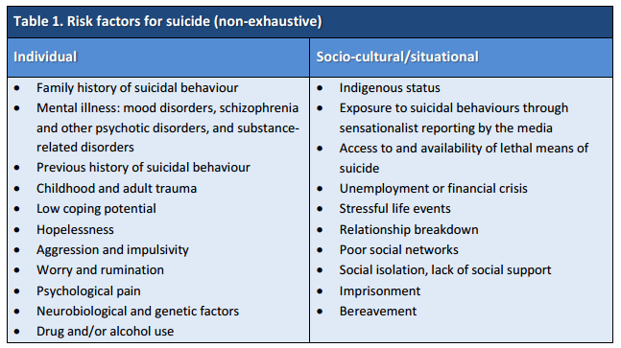
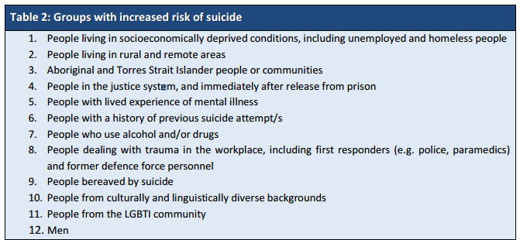
Risk factors

Slide 7
Risk factors cont. (non exhaustive)
Exploitation (e.g. sexual, financial, other)
Loss of reputation
Abuse, neglect
Homelessness
Domestic violence
Falls
Loss of independence
Pet safety
Child safety
Leaving care prematurely
Command hallucinations

Slide 8
Strengths based assessment (useful for fishing for protective factors)
Current strengths and resources (History of the presenting illness)
What keeps you going?
Consider spirituality, social roles, cultural / political identity, self-belief, life skills, toughness, resilience, humour, environmental mastery, support from others, ability to express emotion artistically.
Personal goals (Risk assessment)
How would you like your life to be different? What are your dreams now? How have they changed?
Past coping history (Past psychiatric history)
How have you got through the tough times in your life? What supports have you found useful? What do you wish had happened?
Inherited resources (Genetic background)
Is there any history of high achieving in your family? Any artists, authors, athletes or academics?
Family environment (Family environment)
When you were growing up, was there anyone you really admired? What important lessons did you learn during childhood?

Slide 9
Strengths based assessment cont.
Learning from the past (Precipitating events)
What have these experiences taught you? Are there any positive ways in which you have changed or grown as a person?
Consider gratitude, altruism, empathy, compassion, self-acceptance, self-efficacy, meaning.
Developmental history (Developmental history)
What was life-like for you when you were growing up? What did you enjoy? What’s your best memory? What skills or abilities did you discover you had?
Valued social roles (Occupational history)
What would someone who knew you really well and liked you say about you? What would you like them to say? How are you useful or of value to others?
Social supports (Relationship history)
Who do you lean on in times of trouble? Who leans on you?
Personal gifts (Forensic history, drug and alcohol)
What is special about you? Has anyone ever paid you a compliment? What things that you’ve done or ways that you’ve behaved make you feel really proud of yourself?
A positive identity also emerges from healthy living, eating and fitness, or anything that makes people feel good about themselves.

Slide 10
Protective factors!
Stable social support (friends, family, significant others)
Peer group affiliation
Good coping and problem-solving skills
Positive values and beliefs
Ability to seek and access help
Stable employment & accommodation
Prolonged abstinence from substances
Effective coping and problem-solving skills, hopefulness
Availability of effective treatment, positive engagement with services, therapeutic engagement evident, awareness of early warning signs, concerns about effect of suicide on others
Restricted access to lethal means
Future thinking (thinking about the future!)

Slide 11
Some important self-harm / suicide skills to remember
Remain calm & regulate your own emotions
Put aside judgements & biases
Consider your non-verbal communication, convey calmness, empathy and acceptance
Use active listening and effective communication (empathic + genuine concern + support)
Therapeutic engagement is key in responding to a person at risk of suicide or self-harm
Speak with and consult experienced/senior colleagues
Never agree to secrecy

